Slide 1

Music recommendation engine for Indian users
Team members :
Anand Kumar
Ameena Sulthana
Srija Mohana
Yash Salokhe
Muthamilarasu S
Suresh Goud
Bachu Komal

Slide 2

Business Objective:
To build a feature of recommendation system to support a music app primarily targeted for Indian user

Slide 3
Project Architecture / Project Flow
Understanding the Business Problem
Dataset Understanding
EDA process
Model Building
Model Evaluation
Feedback
Deployment

Slide 4
Data Set Details
The data file contains 114000 observations with 21 variables
In data set each features contain non-null values.
There are no duplicate entries present.
There are total 114 genres of music
There are total 73603 unique songs.
.

Slide 5
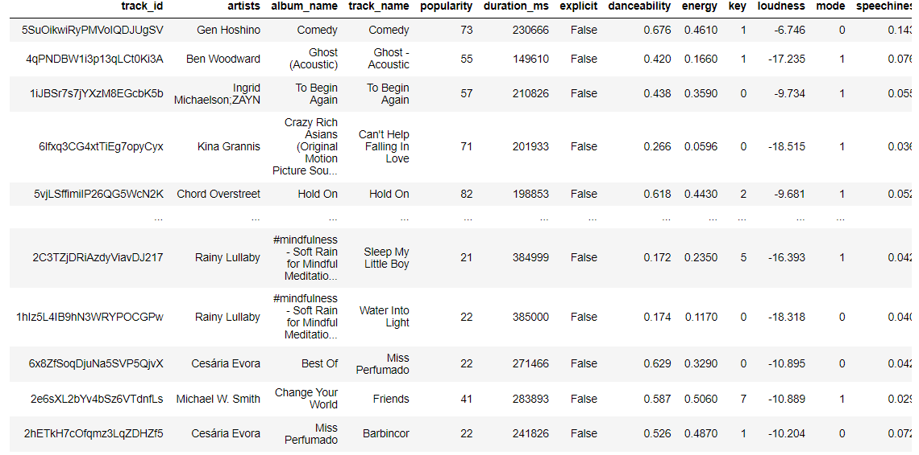
Data Set

Slide 6
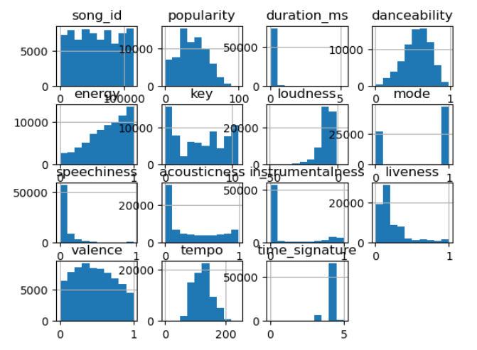
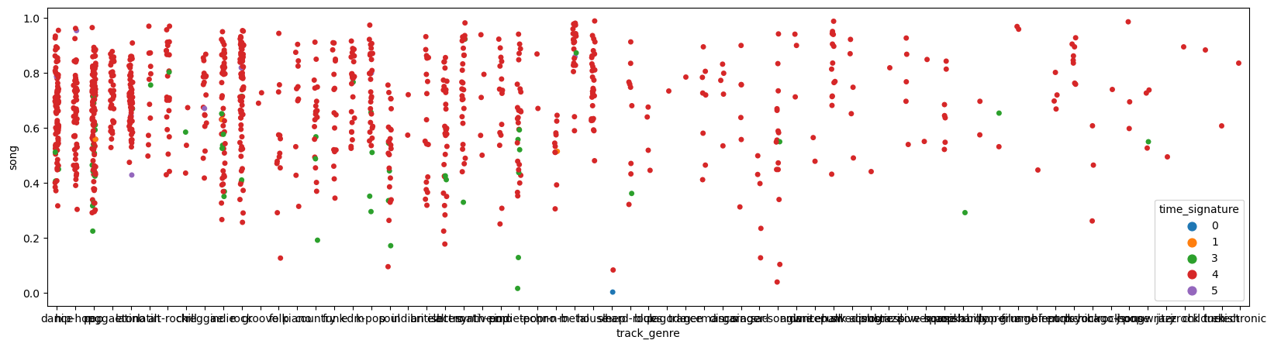
EDA
Hist Plot :
Strip Plot:

Slide 7
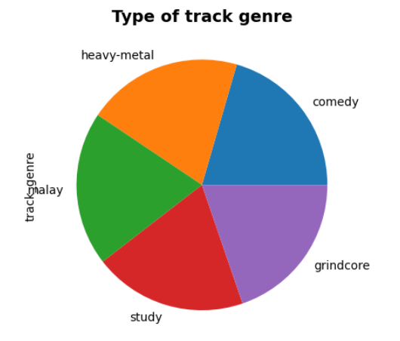
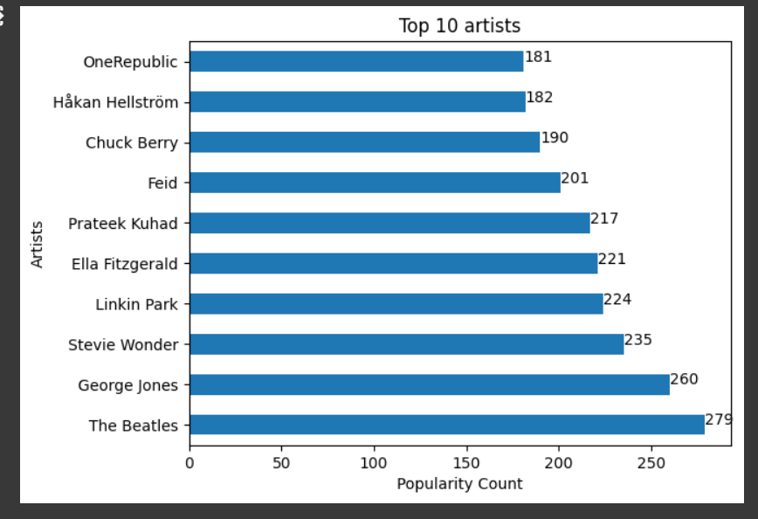
PIE Plot:
BAR Plot : Popular count

Slide 8
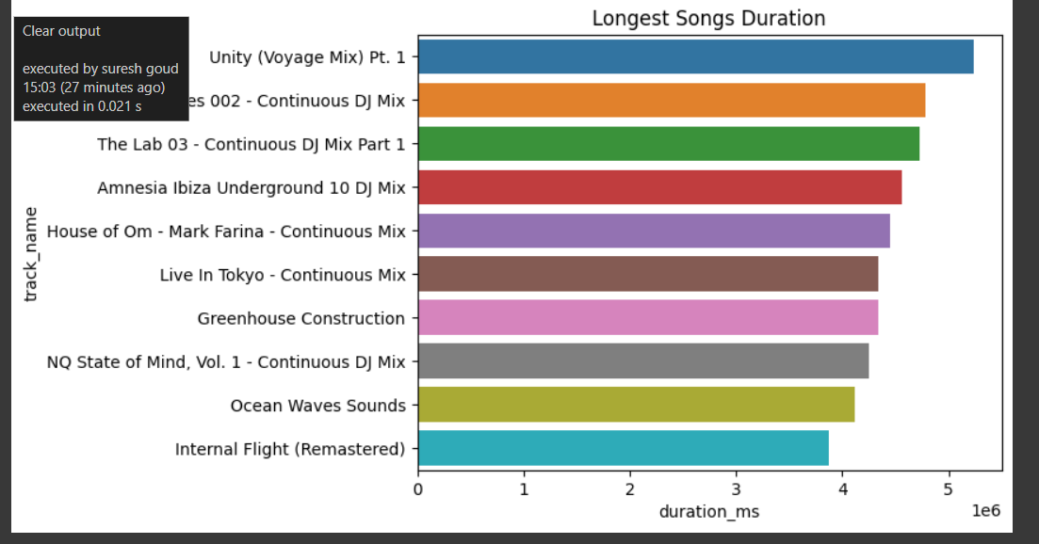
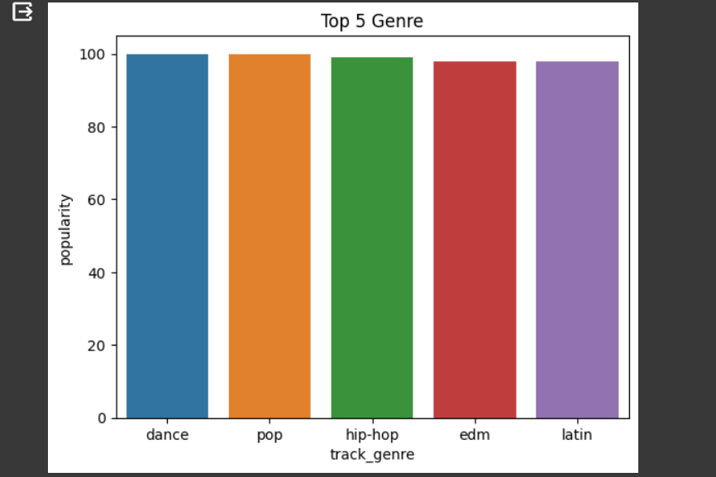
BAR Plot: Duration Time
BAR Plot: Track Genre

Slide 9
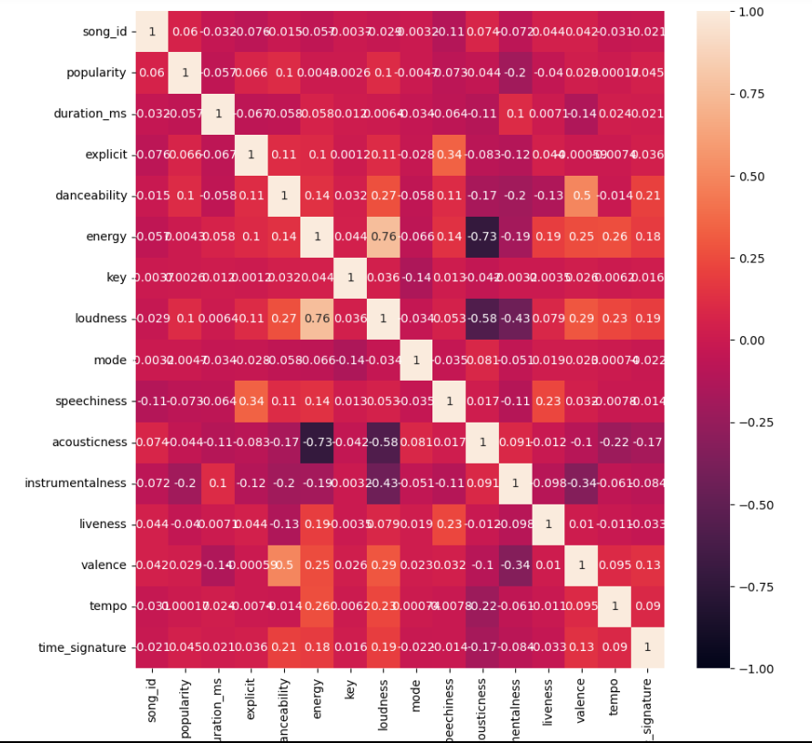
Heat Map

Slide 10
Model Building
Collaborative filtering is a technique that can filter out items that a user might like on the basis of reactions by similar users.
Collaborative filtering algorithms often require (1) users' active participation, (2) an easy way to represent users' interests, and (3) algorithms that are able to match people with similar interests.

Slide 11
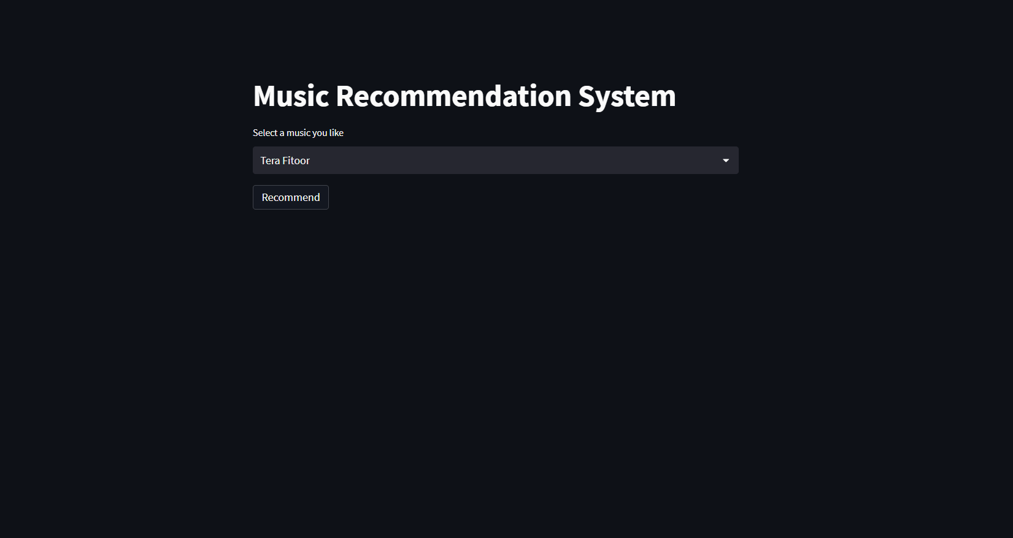
Deployment

Slide 12
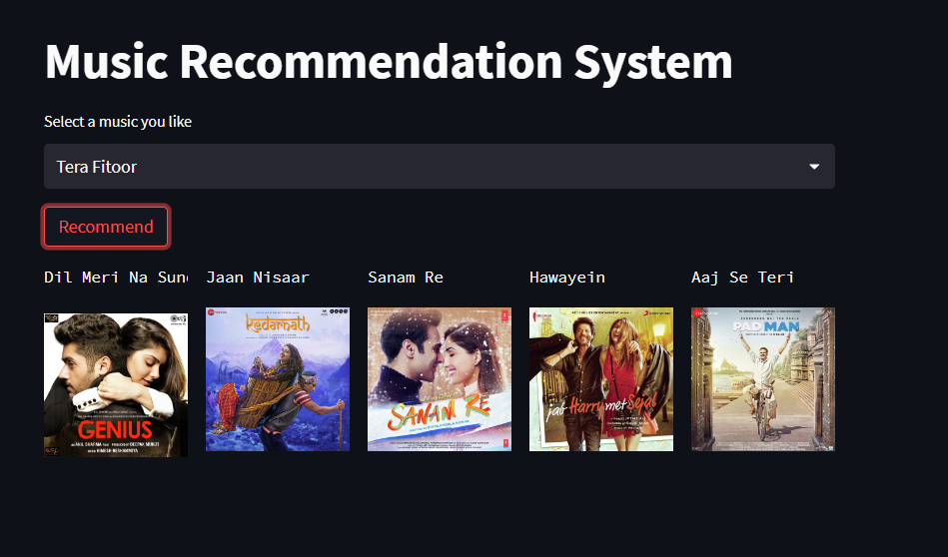

Slide 13
Challenges faced
Communication - As we all are from different walks of life, at the beginning it was difficult to communicate ideas but we overcame it and bonded pretty well
The main challenge we faced was when we were trying to understand about the data.
The other challenge was when we did the deployment

Slide 14

Thank You

